Slide 1

VIDEO SUMMARIZATION WITH NLP AND VLM
TEAM MEMBERS – GROUP 16
SAKSHI TOKEKAR
NIKHIL SESHA SAI KONDAPALLI
BHARGAVA SIVA NAGA SAI POTLURI
KAVIMAYIL PERIYAKORAVAMPALAYAM KOMARASAMY

Slide 2

VIDEO SUMMARIZATION: THE CHALLENGE
The Problem
Why Video Summarization Matters
Information Overload: Exponential growth necessitates efficient processing.
Millions of videos uploaded daily create an overwhelming content volume, surpassing human capacity for consumption and navigation.
Time Constraints: Users need quick access to essential content.
Efficient Retrieval: Crucial for search, navigation, and content discovery.
Semantic Understanding: Capturing narrative and meaning, beyond visual saliency.
Key Challenge: Existing methods often fall short in capturing the semantic content and narrative structure, relying heavily on visual features and temporal dynamics.

Slide 3





OUR SOLUTION: LLMVS FRAMEWORK
Video Frames
Inspired by Video Summarization with Large Language Models (Lee et al., CVPR 2025)
M-LLM
(Caption Generation)
Core Innovation: Leveraging Large Language Models' inherent semantic understanding and contextual reasoning capabilities for highly effective video summarization.
LLM (Local Scoring)
Self-Attention (Global Context)
Importance Scores

Slide 4

Three Key Components of LLMVS
01
02
03
Text Description Generation
Local Importance Scoring
Global Context Aggregation
A Multi-modal LLM (LLaVA-1.5-7B) converts video frames into textual captions
LLM (Llama-2-13B) evaluates frame importance using sliding window context
Self-attention mechanism captures dependencies across the entire video
Key Strategy: We utilize LLM output embeddings rather than direct text answers, extracting richer semantic information for a more profound understanding of video content.

Slide 5

Benchmark Datasets:
TVSum Dataset
Size: 50 videos
Duration: 2-10 minutes (avg: 4m 11s)
Content: How-to videos, documentaries, vlogs
SumMe Dataset
Size: 25 videos
Duration: 1-6 minutes (avg: 2m 40s)
Content: Holidays, events, sports captured with egocentric, moving, and static cameras
Evaluation Metrics:
Ranking Metrics for Frame Importance:
Kendall's τ
Spearman's ρ
Text Similarity Metrics for Caption Quality:
Rouge
BERTScore
Cosine Similarity

Slide 6
ARCHITECTURE PIPELINE

Slide 7
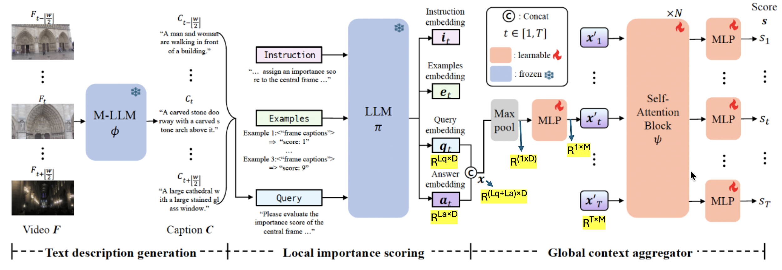
Overall Architecture
Local context embeddings:​
Query Embeddings (qt)- Encode semantic information of the video frames within the local context.​
Answer Embeddings (at)- They encode the evaluation result or the model's judgment of the frame's importance based on the provided examples and instructions.​
x = q_{t}+a_{t} , captures overall local context.​

Slide 8
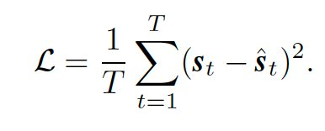
Training Objective & Video Segmentation:​
Training Objective:​
The method is trained using the Mean SquaredError (MSE) loss to optimize frame importance predictions.​
The loss L between the ground truth score vector's and the predicted score s and is defined as:​
Goal: Select video segments constituting 15% of the video length
MCP (Maximum Cohesive Subset) / KTS (Kernel Temporal Segmentation):​
KTS: Segments the video into semantically consistent shots.​
0/1 Knapsack Algorithm: Selects segments to maximize total importance score while staying within the 15% length constraint.​

Slide 9
IMPLEMENTATION

Slide 10
TVSum Dataset Features
50 videos of various genres in TVSum Dataset​
Train Test Split : 40 Videos for Training and 10 Test Videos​
One Sample Annotated Video Metadata from the dataset:​
Video Id: 38, Video Length: 94 secs
Number of Frames: 2941
fps (frames per second): 30
Feature Steps/Picks: 197 (Video Specific)​
Key​ | Space​ | Description​
picks​ | (197,)​ | The specific frame indices that were sampled to generate the features (e.g., frame 0, 15, 30, etc.).​
features​ | (197, 1024)​ | The extracted visual features (GoogLeNet pool5) for each of the 197 steps.​
gtscore​ | (197,)​ | The ground truth importance score (0-1) for each step, averaged from user annotations.​
n_frame_per_seg | (20,)​ | The number of frames contained in each of the 20 segments.​
change_points​ | (20, 2)​ | The start and end frame indices for each of the 20 video segments (shots).​

Slide 11
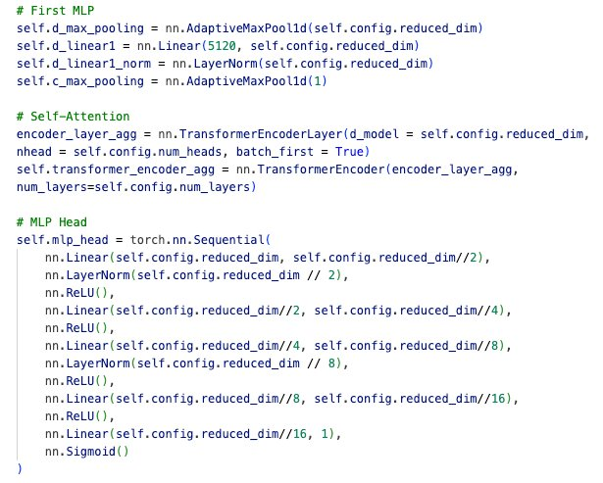
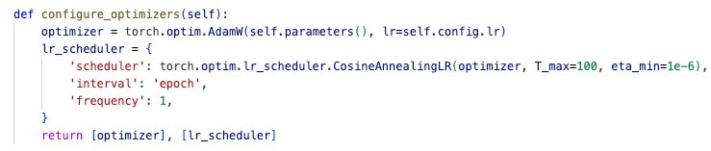
Model Training:
Hyperparameters:
reduced_dim: 2048
num_heads: 2
num_layers: 3
epochs: 200
Learning rate: 7e-5 (TVSum)

Slide 12

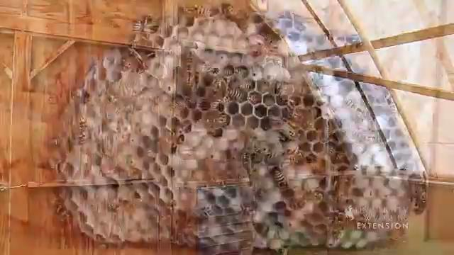
Original Video
Summarized Video by our model

Slide 13
EVALUATION

Slide 14
COMPARISON OF IMPORTANCE SCORES
Method | Kendall's τ | Spearman's ρ
A2Summ* | 0.137 | 0.165
LLM* | 0.051 | 0.056
Our Approach | 0.177 | 0.229
*Reference: Lee, M. J., Gong, D., & Cho, M. (2025). Video Summarization with Large Language Models. In Proceedings of the IEEE/CVF Conference on Computer Vision and Pattern Recognition (CVPR 2025), pages 18981–18991.

Slide 15
SAMPLE SUMMARY
Original video
Model output
The video, presented by Jeff Edwards of the University of Wyoming Extension, discusses the Paper Wasp and how to manage its nests, particularly around homes and gardens. Edwards first points out that paper wasps are actually beneficial insects because they help control garden pests like caterpillars. However, their presence can be problematic because they are indiscriminate stingers when disturbed. Edwards recommends that when spring cleaning or gardening, homeowners should take the opportunity to remove any wasp nests found, especially those in the eaves of structures where they could pose a threat to people or pets. He demonstrates how a nest can be physically knocked down with a shovel or other implement and then thrown away. Alternatively, he suggests using chemical control specifically designed for wasp and hornet control. For chemical removal, he advises applying the product in the evening when all the wasps have returned to the nest, and then cleaning the dead wasps and the nest off the structure.
The video provides a tip for homeowners during spring cleaning and gardening preparation, recommending the removal of certain insect nests found on homes and other structures. Specifically, it focuses on paper wasp nests, which are often found under the eaves. The speaker suggests that these nests, when discovered early, can be safely knocked down using a shovel or other implement. The key takeaway is to take the opportunity during spring maintenance to inspect and remove these nests, simplifying the process by addressing them while the colonies are still small or before they become fully established for the season.

Slide 16
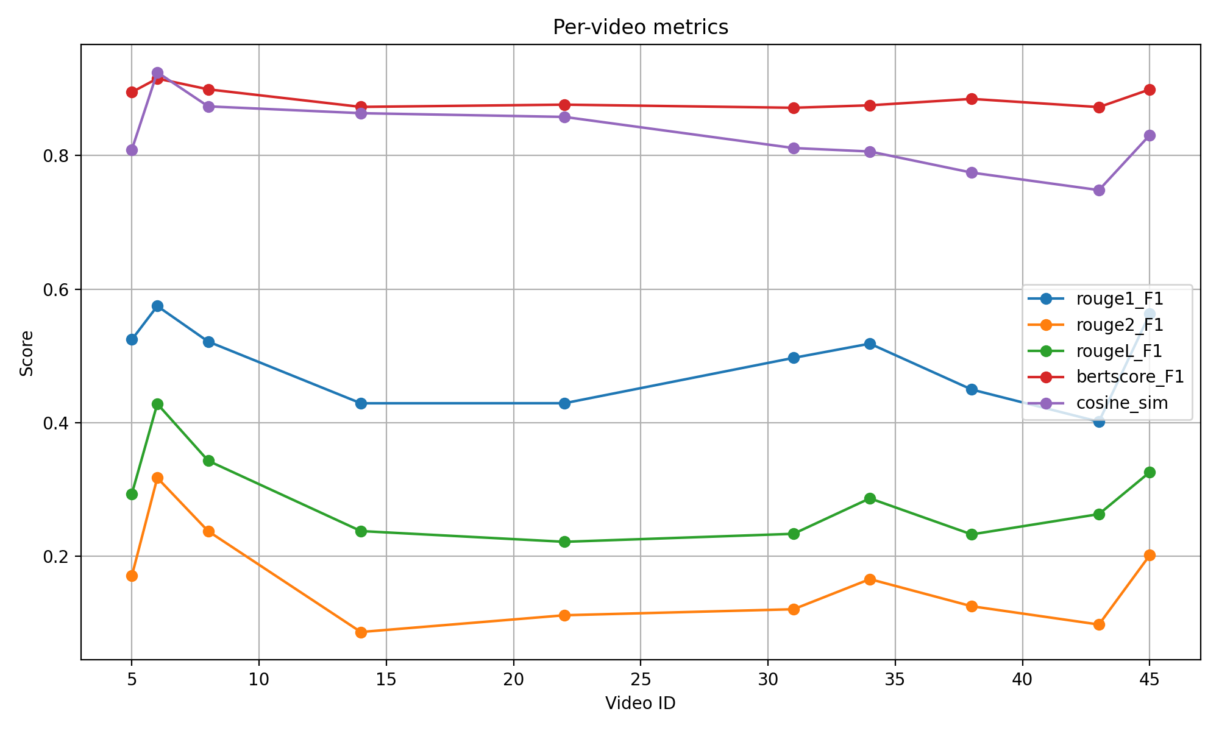
VIDEO SUMMARY EVALUATION

Slide 17



FUTURE WORK
EXTEND TO DIVERSE DATASETS AND TEST GENERALISATION
INCLUDE "AUDIO" MODALITY DURING SUMMARIZATION TO ENRICH CONTEXT
EXPERIMENT WITH DIFFERENT M-LLMS & LLMS TO IMPROVE EFFICIENCY

Slide 18
REFERENCES
https://arxiv.org/pdf/2504.11199
https://www.geeksforgeeks.org/nlp/understanding-bleu-and-rouge-score-for-nlp-evaluation/
https://github.com/mlee47/LLMVS/tree/main

Slide 19
Thank you!
We are open to questions.

